Slide 1
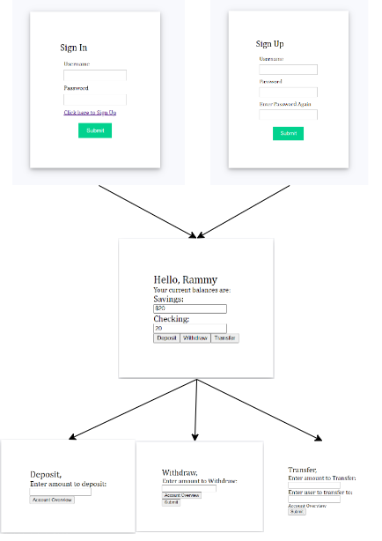
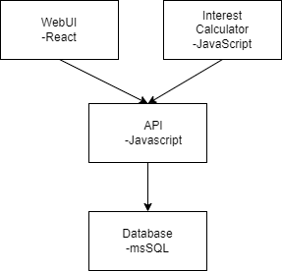
Banking App for CSC 468
WebUI Flow Chart
Project Flow Chart
We created a simulated banking app which includes a sign in/up page, an account summary page, a deposit, a withdraw, and a transfer page.
The WebUI of our project accesses our database through an API for various reasons: the sign in page to verify account information, the sign up page to insert new account information, the account summary page to show account balances, and the deposit, withdraw, and transfer page to change the balances.
We also have a separate Javascript file to add interest to appropriate balances that also accesses the database through the API.
Some of the issues we ran into were having to learn to build the front end from scratch, which included learning react. We also had to learn how to create an SQL server and access it using express and rest APIs
Created By: Austin Heard, David Dempsey, Youssuf Kromah, Ben Ejimonyeugwo
https://github.com/dcdemps/468project.git

